Slide 1
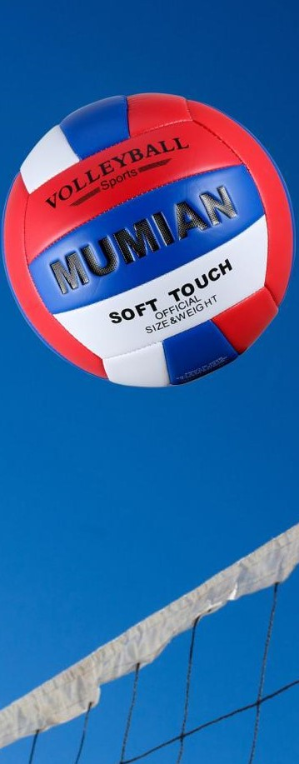
Westside High School
Week At a Glance (WAG)

Slide 2
Coach Thomas
Rec. Games: August 15th -19th

Slide 3
Monday - Agenda
Standard:
PERG.1 The physically educated student demonstrates competency in a variety of motor skills and movement patterns.
a. Demonstrates competence while performing skills in a variety of recreational game settings and activities
b. Performs skills at a level of competence, which contributes to health-related fitness.
c. Demonstrates proper warm-up and cool-down protocol associated with different life time
sport physical activities.
PERG.3 The physically educated student demonstrates knowledge and skills to help achieve
and maintain a health-enhancing level of physical activity and fitness.
a. Maintains or improves fitness level by using the results of the Georgia Fitness Assessment
to guide changes in a personal program of physical activity.
b. Uses technologies to assess, enhance, and maintain health-related and skill-related fitness.
c. Analyzes the relationship between physical activity and longevity.
Personal and Social Behavior, Rules, Safety, and Etiquette
Learning Target
I can explain the basic rules of volleyball
I can use and demonstrate the proper technique to bump a volleyball
Opening ( 10-15 mins)
10 minute Walk & Attendance
Work-session ( 20 - 25 mins)
Locker rooms unlocked & students go to bleachers to track & record distance & heart rate (partner with someone near you during walk if you don’t have tracking device: post on canvas)-5 minutes then locked
Coach will review: Learning Target, Basic rules of volleyball, how to bump a volleyball
Students will participate in bumping drills
Criteria for Success
I can explain the importance of the rules, procedures, and expectations overall and specifically.
Closing ( 05 – 10 mins)
-locker room unlocked for 5 minutes
-students use remaining time to cool down & rehydrate if necessary

Slide 4
Tuesday - Agenda
Standard:
PERG.1 The physically educated student demonstrates competency in a variety of motor skills and movement patterns.
a. Demonstrates competence while performing skills in a variety of recreational game settings and activities
b. Performs skills at a level of competence, which contributes to health-related fitness.
c. Demonstrates proper warm-up and cool-down protocol associated with different life time
sport physical activities.
PERG.3 The physically educated student demonstrates knowledge and skills to help achieve
and maintain a health-enhancing level of physical activity and fitness.
a. Maintains or improves fitness level by using the results of the Georgia Fitness Assessment
to guide changes in a personal program of physical activity.
b. Uses technologies to assess, enhance, and maintain health-related and skill-related fitness.
c. Analyzes the relationship between physical activity and longevity.
Personal and Social Behavior, Rules, Safety, and Etiquette
Learning Target
I can explain the basic rules of volleyball
I can use and demonstrate the proper technique to set a volleyball
Opening ( 10-15 mins)
10 minute Walk & Attendance
Work-session ( 20 - 25 mins)
Criteria for Success
Locker rooms unlocked & students go to bleachers to track & record distance & heart rate (partner with someone near you during walk if you don’t have tracking device: post on canvas)-5 minutes then locked
Coach will review: Learning Target, Basic rules of volleyball, how to set a volleyball
Students will participate in setting drills
I can correct errors of myself and others based on the rules of volleyball
I can list the steps for properly setting a volleyball
Closing ( 05 – 10 mins)
Teacher assess student understanding by show of hands

Slide 5
Wednesday - Agenda
Standard:
PERG.1 The physically educated student demonstrates competency in a variety of motor skills and movement patterns.
a. Demonstrates competence while performing skills in a variety of recreational game settings and activities
b. Performs skills at a level of competence, which contributes to health-related fitness.
c. Demonstrates proper warm-up and cool-down protocol associated with different life time
sport physical activities.
PERG.3 The physically educated student demonstrates knowledge and skills to help achieve
and maintain a health-enhancing level of physical activity and fitness.
a. Maintains or improves fitness level by using the results of the Georgia Fitness Assessment
to guide changes in a personal program of physical activity.
b. Uses technologies to assess, enhance, and maintain health-related and skill-related fitness.
c. Analyzes the relationship between physical activity and longevity.
Personal and Social Behavior, Rules, Safety, and Etiquette
Learning Target
I can explain the basic rules of volleyball
I can use and demonstrate the proper technique to hit & serve a volleyball
Opening ( 10-15 mins)
10 minute Walk & Attendance
Work-session ( 20 - 25 mins)
Locker rooms unlocked & students go to bleachers to track & record distance & heart rate (partner with someone near you during walk if you don’t have tracking device: post on canvas)-5 minutes then locked
Coach will review: Learning Target, Basic rules of volleyball, how to hit/kill and serve a volleyball
Students will participate in hitting & serving drills
Criteria for Success
Same as previous day.
Closing ( 05 – 10 mins)
-locker room unlocked for 5 minutes
-students use remaining time to cool down & rehydrate if necessary

Slide 6
Thursday - Agenda
Standard:
PERG.1 The physically educated student demonstrates competency in a variety of motor skills and movement patterns.
a. Demonstrates competence while performing skills in a variety of recreational game settings and activities
b. Performs skills at a level of competence, which contributes to health-related fitness.
c. Demonstrates proper warm-up and cool-down protocol associated with different life time
sport physical activities.
PERG.3 The physically educated student demonstrates knowledge and skills to help achieve
and maintain a health-enhancing level of physical activity and fitness.
a. Maintains or improves fitness level by using the results of the Georgia Fitness Assessment
to guide changes in a personal program of physical activity.
b. Uses technologies to assess, enhance, and maintain health-related and skill-related fitness.
c. Analyzes the relationship between physical activity and longevity.
Personal and Social Behavior, Rules, Safety, and Etiquette
Learning Target
I can demonstrate my mastery of this week’s learning targets
Opening ( 10-15 mins)
5 minute Walk & Attendance
Work-session ( 20 - 25 mins)
Teacher explain assessment procedure
-Students will be called to perform assessments based on teacher expectations of skills learned this week
Criteria for Success
I can use the proper technique to perform volleyball skills (bump, set, hit, serve)
Closing ( 05 – 10 mins)
-locker room unlocked for 5 minutes
-students use remaining time to cool down & rehydrate if necessary

Slide 7
Friday - Agenda
Standard:
PERG.1 The physically educated student demonstrates competency in a variety of motor skills and movement patterns.
a. Demonstrates competence while performing skills in a variety of recreational game settings and activities
b. Performs skills at a level of competence, which contributes to health-related fitness.
c. Demonstrates proper warm-up and cool-down protocol associated with different life time
sport physical activities.
PERG.3 The physically educated student demonstrates knowledge and skills to help achieve
and maintain a health-enhancing level of physical activity and fitness.
a. Maintains or improves fitness level by using the results of the Georgia Fitness Assessment
to guide changes in a personal program of physical activity.
b. Uses technologies to assess, enhance, and maintain health-related and skill-related fitness.
c. Analyzes the relationship between physical activity and longevity.
Personal and Social Behavior, Rules, Safety, and Etiquette
Learning Target
Freestyle Friday
Opening ( 10-15 mins)
Attendance
Work-session ( 20 - 25 mins)
Students are able to engage in various activities/sports typically those that they are most interested
Teacher will conference will students and possibly make parent phone calls/contact as needed
Criteria for Success
I can demonstrate my understanding of the rules, procedures, and expectations by following them during class time and asking questions to teacher if necessary.
Closing ( 05 – 10 mins)
N/A

Slide 8
Resources
https://www.nike.com/nrc-app
https://www.youtube.com/watch?v=4vnD991J22g

